Slide 1




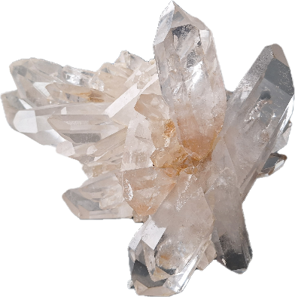
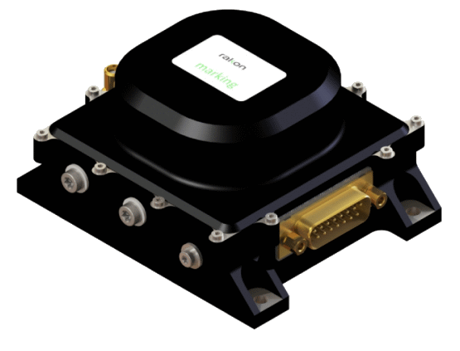



6th SPACE PASSIVE COMPONENT DAYS - SPCD 2026
13-16 October 2026 | ESA/ESTEC
Noordwijk, The Netherland
MINCOR - Minimisation of crystal oscillator cosmic radiation effects
Follow up & conclusion
ESA contract No. 4000133592/20/NL/FE
Nicolas GUFFLET, Laurent COUTELEAU, Rami KHOURI / RAKON
Yannick PADIE, Alexandre ROUSSET / TRAD

Slide 2
Table of content
Reminder
Presentation of results
Conclusion and perspective

Slide 3
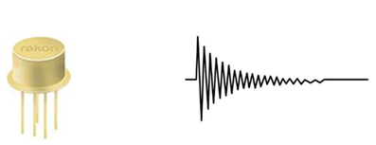
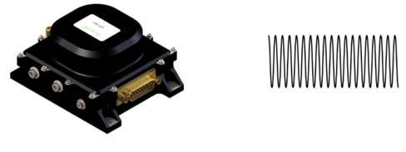
Reminder : Quartz resonator & oscillator
Resonator : passive component
Oscillator : active component
Main word : frequency F ~ 5…150MHz and especially frequency stability : ΔF/ F : 10⁻⁶ … 10⁻¹⁰ … 10⁻¹⁴
Designed to be insensitive to external environnement : temperature, acceleration, pressure, time,… and radiation

Slide 4
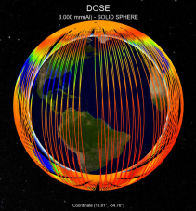
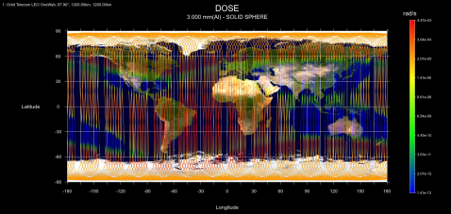
Radiation sensitivity
Radiation may generate frequency drift at low dose rate (LDR) and cumulated over the mission duration (TID)
Radiation profiles depend on mission and LDR will have a special role in LEO where there is periodic radiation cycles
Dose rate mapping for Telecom LEO orbit. 3D view (left) ; Planisphere view (right)

Slide 5
Test plan realized
Sensitivity to cycling LDR is assessed before and after a 100krad deposition
Continuous frequency measurement
Frequency measurement before/after
Continuous frequency measurement
Low dose rate Cycling
Few rad/h
Radiation ON / OFF cycling with continuous measurement of frequency in dummy oscillator
High dose 100krad
deposition
on resonator
Low dose rate Cycling
Few rad/h
Radiation ON / OFF cycling with continuous measurement of frequency in dummy oscillator
Device characterization
Device characterization
Device characterization
Device characterization

Slide 6
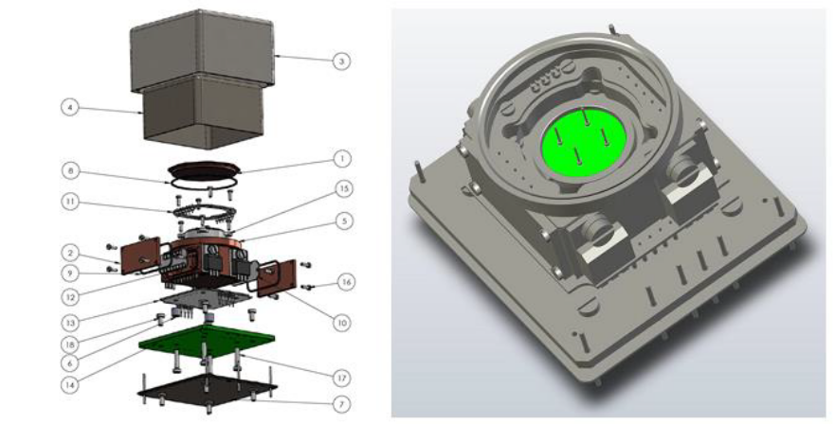
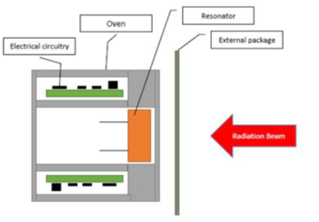
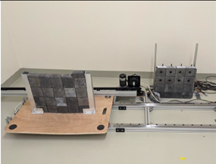
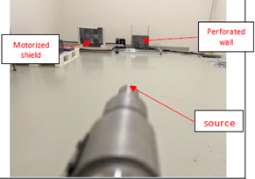
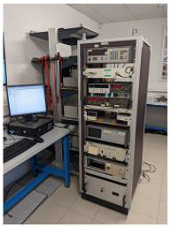

LDR cycling sensitivity assessment
Use of a Cobalt 60 gamma ray source at few rad/h
Resonator measurement in dummy oscillator
Radiation ON/OFF cycle done with a moveable lead wall (*)
Test oscillators
Oscillator structured so as to expose ony the resonator in the beam
Motorized shield open
Image of the lead wall from the source
Measurement system
*Note: lead wall not fully opaque to gamma ray : 10% transparency

Slide 7
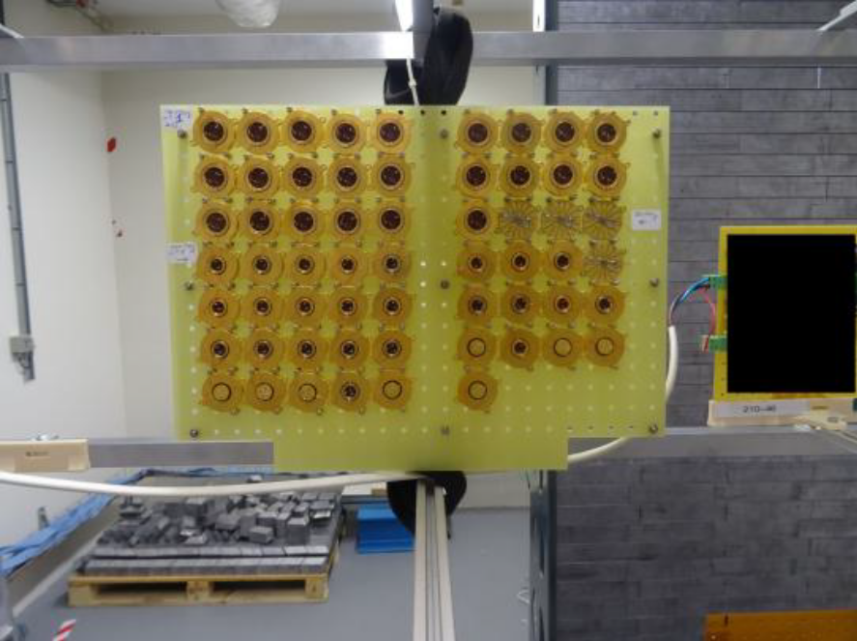
High dose deposition
Use of Cobalt 60 gamma ray source
100krad deposited @ 220rad/h during roughly 20 days
Done on resonator only to avoid the effect of the oscillator
Board with 60 resonators for 100krad TID

Slide 8
Test vehicules used
15 variants with different design and processes (frequency enclosure, cut, material, electrodes,…)
6 variants for T1507 10MHz SC-cut resonators
8 variants for T807 100MHz AT- and SC-cut resonators
1 variant for SMD 50MHz AT-cut resonators
200+ resonators produced over the 15 groups with all corresponding datapackages
Resonators produced as per specification on the ESCC3501 qualified line
In each group, 4 pieces selected as considered to be representative
60 resonators in total available for radiation tests

Slide 9
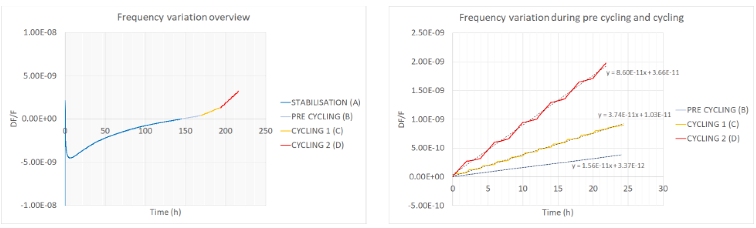
Basic behaviours under LDR cycling
Osc. 10MHz n°1
2 differents cycles applied @ 6 rad/h
Cycle 1 : 20min ON / 100min OFF
Cycle 2 : 120min ON / 120min OFF
Cumulative positive frequency drift
Frequency variation overview (left) and slopes comparison (right) for Osc. 10MHz n°1
In this example, values of 2.6.10-11/rad can be deduced

Slide 10
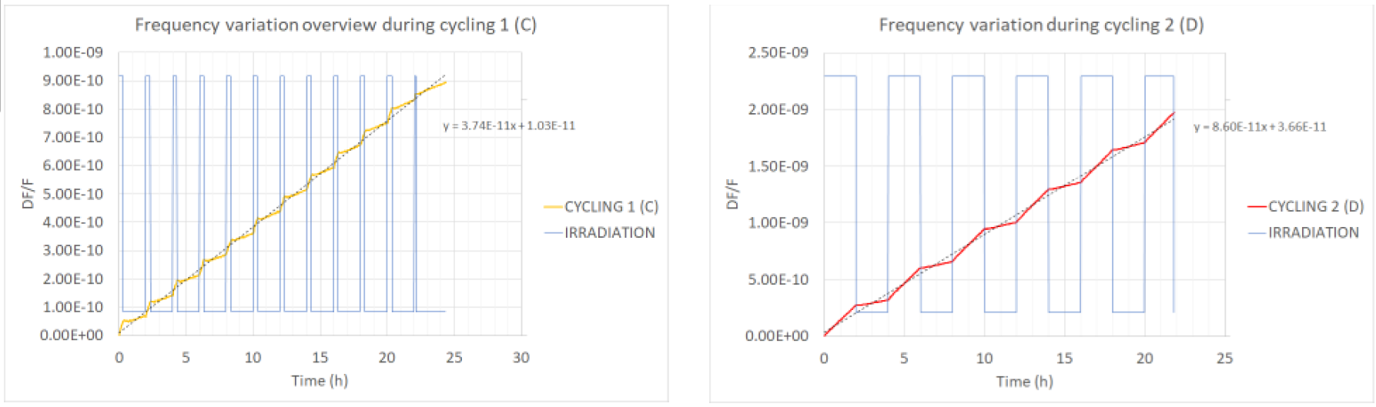
Basic behaviours under LDR cycling
Osc. 10MHz n°1
Linear slopes with clear transition at ON/OFF period
Frequency variation during irradiation cycling 1 (left) and 2 (right) for Osc. 10MHz n°1

Slide 11
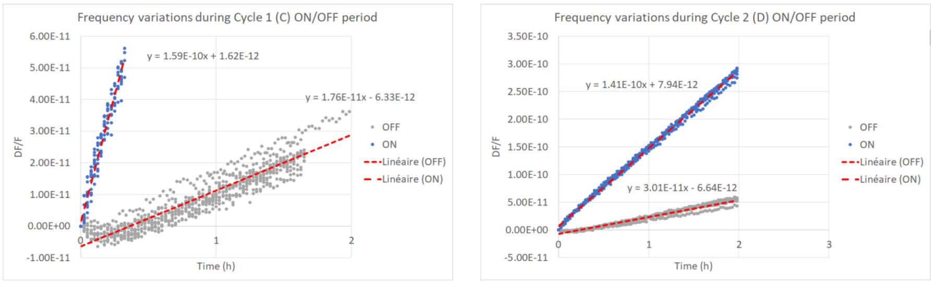
Basic behaviours under LDR cycling
Osc. 10MHz n°1
Slopes are correlating also when looked within each ON or OFF period
Frequency variation during ON/OFF periods for cycle 1 (left) and cycle 2 (right) for Osc. 10MHz n°1

Slide 12
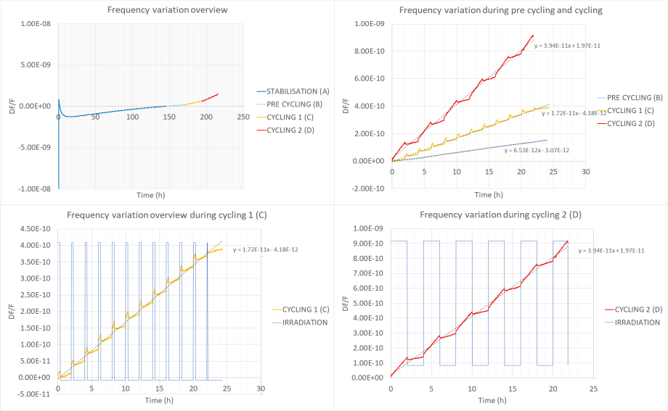
Other signatures
Osc. 10MHz n°2
Cumulative positive frequency drift superimposed with sudden but reversible positive frequency drift
Sudden positive frequency shift around 2.5e-11 in this example
with relaxation-like behavior when coming back
Frequency variation during stabilization and irradiation cycling for Osc. 10MHz n°2

Slide 13
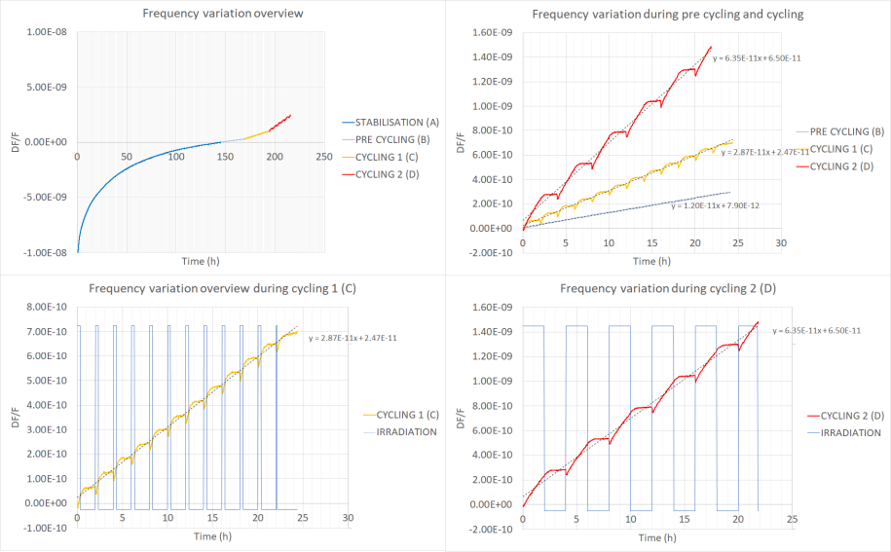
Other signatures
Osc. 10MHz n°11
Cumulative positive frequency drift superimposed with sudden but reversible negative frequency drift
Relaxation-like behavior at beginning of OFF period leads to quite jagged curves
Frequency variation during stabilization and irradiation cycling for Osc. 10MHz n°11

Slide 14
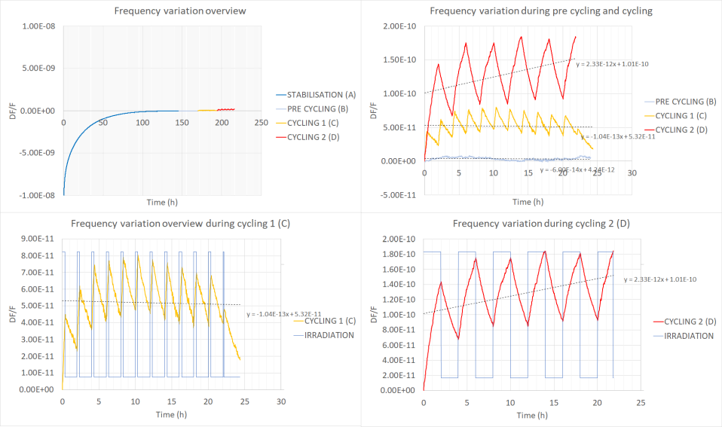
Other signatures
Osc. 10MHz n°5
Non cumulative positive frequency drift with a kind of saturation effect
Frequency variation during stabilization and irradiation cycling for Osc. 10MHz n° 5 (swept material)

Slide 15
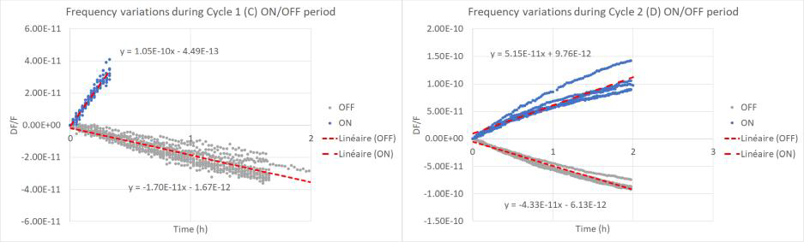
Equilibrium depends on duration
Osc. 10MHz n°5
At this level, the phenomena are not linear hence equilibrium depends upon ON/OFF cycle durations
Slope around 0.85.10⁻¹¹/rad
Slope around 1.75.10⁻¹¹/rad
Frequency variation during ON/OFF periods for cycle 1 (left) and cycle 2 (right) for Osc. 10MHz n° 5

Slide 16
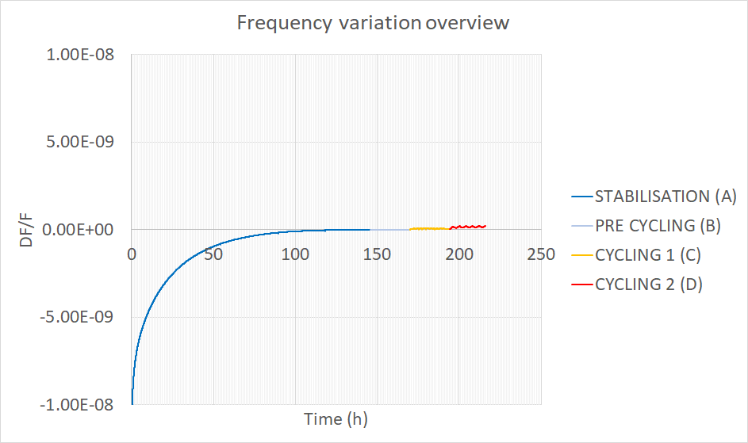
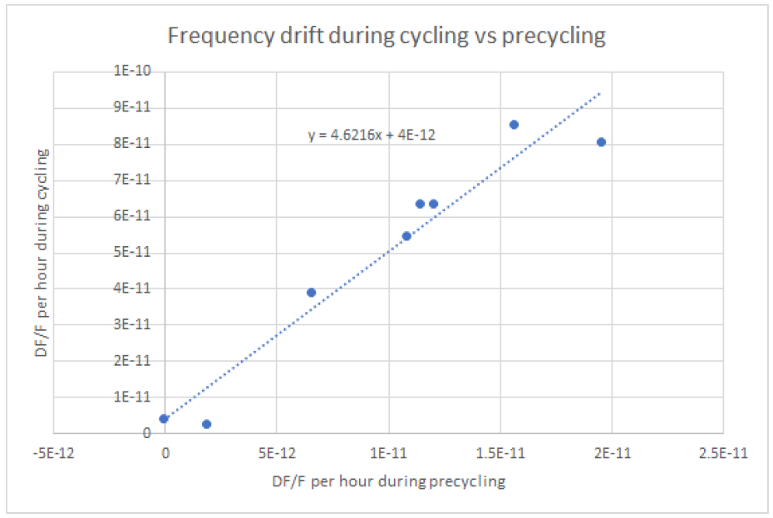
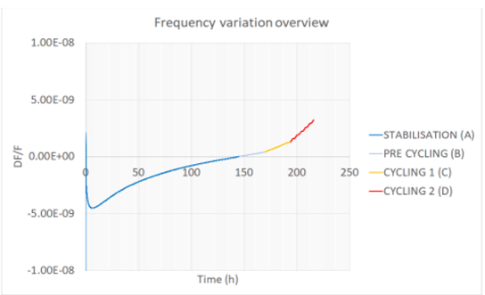
Effect of the lead wall transparency
Time to stabilize linked to the resonator sensitivity shows impact of wall transparency
…
Frequency drift correlation between pre-cycling (B) and cycling 2 (D)

Slide 17
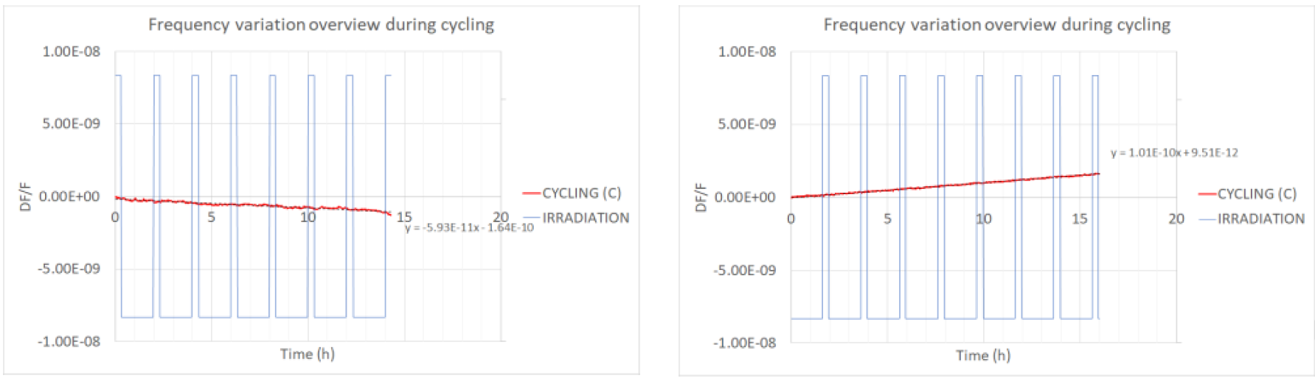
Signatures of the 50 and 100MHz
Osc. 100MHz n°4 and Osc. 50MHz n°4
Resonators produced in the study do not present LDR sensitivity at these frequencies
To be noticed that 50MHz where produced using non swept Standard Quality quartz
Frequency variation during ON/OFF periods for Osc. 100MHz n°4 (left) and Osc. 50MHz n°4 (right)

Slide 18
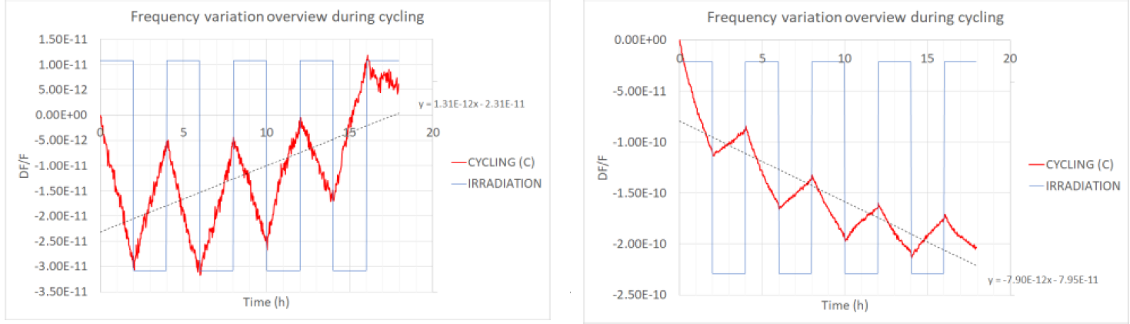
After 100krad TID
Change of frequency before/after TID : Frequency variations before and after the 100krad TID remain below few 10-12/rad for all 60 resonators
LDR sensitivity after TID : stabilize and possibly reverse
Negative slope during radiation
LDR sensitivity after TID for Osc. 10MHz n°1 (left) and Osc. 100MHz n°2 (right)

Slide 19
Synthesis
In this presentation we exposed some results of the MINCOR project :
  Different kind of signature during LDR cycling (cumulative/non-cumulative, fast/slow, positive/negative…)
  Order of magnitude in the range of few 10⁻¹¹/rad in LDR cycling
  10MHz resonators present a signature
  50MHz and 100MHz do not present LDR sensitivity at the measurable level
  Relative frequency changes of few 10⁻¹²/rad over 100krad (non-linear effect)
  Saturation effect clearly visible on swept material without pre-irradiation
  Saturation effect clearly visible with pre-irradiation on non swept material
  Radiation sensitivity could not be linked to other process parameters

Slide 20
Perspective
What does it imply for LEO ?
For LEO particularly, it is important to take the LDR cycling into account not only the TID
The sensitivity to radiation must be seen as per the need :
  zero does not exist. Pass/Fail criteria depends on the specification, on design and on mission profile (path and duration)
  In a lot of application values of few 10-11/rad will be fully sufficient
  In more demanding LEO applications, swept material is recommended because already stabilized
  If needed a pre irradiation can be performed
  This must be decided at manufacturer level : know your products !
W.r.t. quartz material : Low impurities content is needed however the main challenge is to have values guaranteed by suppliers.
In the present study the worse material had impurities measured @ 1ppm which remains low but could not be guaranteed by supplier.

Slide 21
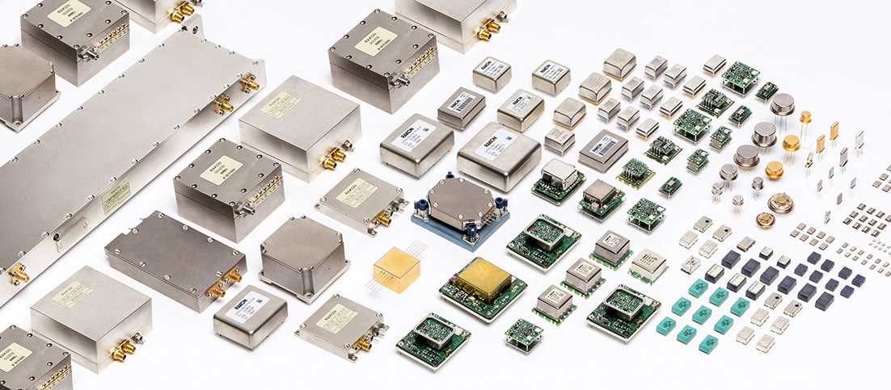
Thank you !
www.rakon.com
Equipment • Subsystems • Oscillators • Filters • Resonators

